Slide 1
Design Thinking Phase 3:
Ideating, Prototyping, & Testing
By: Vennela Gajjala, Haoyang Li, Mounika Tarigopula, Noah Placke
Team S.A.C.S (Students Against Comic Sans) (Team 8)

Slide 2
RQ: Shopping Habits in a Post-Pandemic World Among 20-24 Year Old Students Living Independently

Slide 3



Laddering Challenge Statement
Ladder up: How might we minimize the stress of shoppers during the pandemic?
How might we minimize the time and effort needed by shoppers to find the groceries they need during the pandemic in order to save time and reduce expenditures?
Ladder down: How might we minimize the time needed by shoppers to compare the availability and price of products between different stores reducing effort and risk of exposure?

Slide 4

Problem Statement
Chester has trouble finding items he needs to buy and has been traveling store to store in search of them, and wants an easy way to see what’s in stock, where, and at what price before he spends time traveling anywhere as he is conscious about being exposed to COVID-19.

Slide 5
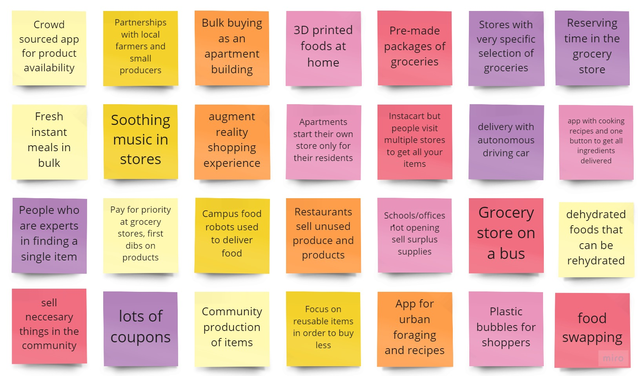
Solution Ideas

Slide 6
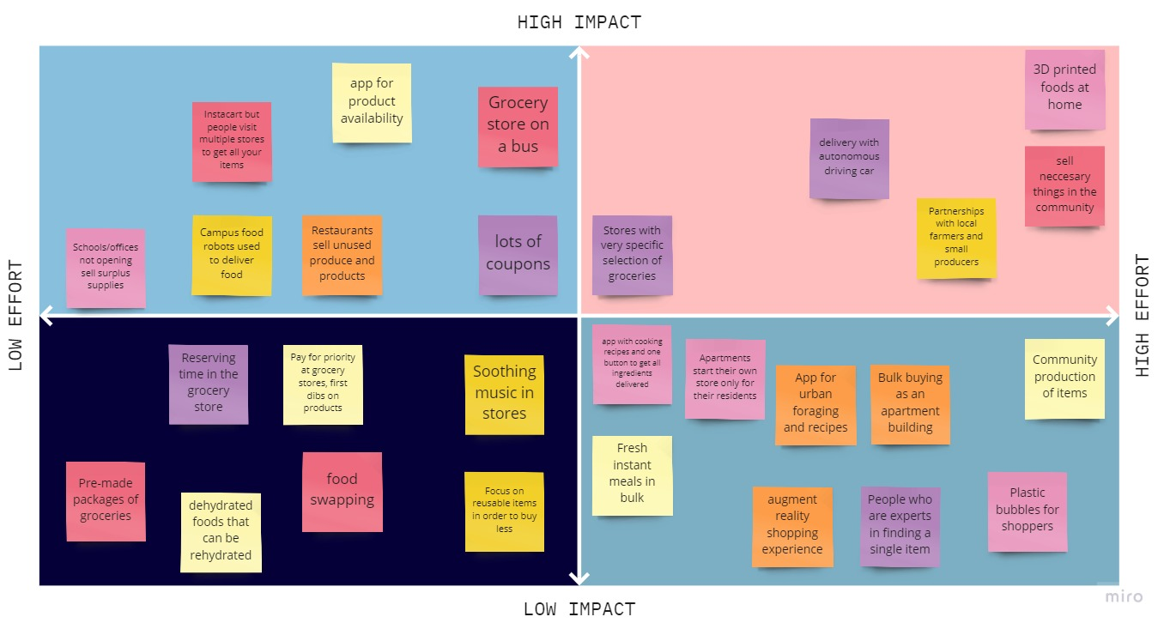
Solution Sorting

Slide 7

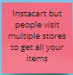
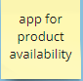
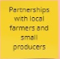
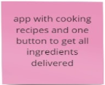
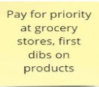
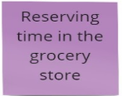
Connection to Insights
People are concerned about product availability and want to be able to get all the products they need, while being safe and reducing exposure. Ordering online at multiple places or being able to visit one store with most/all your items does just that.
The pandemic has changed eating and cooking habits as people become more health conscious and are eating out less. Getting all the ingredients needed to cook a meal in one click provides convenience and partnering with local farms helps solve some of the product availability issues while allowing people to get fresh produce
People want a calming shopping experience, and many participants said they shopped late at night pre-pandemic for that calm atmosphere. Allowing people to reserve time at grocery stores or pay for a priority hour would serve to provide them a relaxing shopping experience in a less crowded stores, also lowering the risk of exposure.

Slide 8

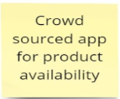
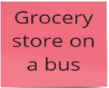
Chosen Ideas
Insight:
People want to be able to find all their products they need without aimless traveling store to store, increasing their chance of exposure
People are more conscious of their spending during the pandemic and it can be easy to save money by comparing costs in different stores
Insight:
People want one place that has all the items they need that reduces exposure while fitting into their current shopping schedule
People feel unsafe using public transportation and online shopping/delivery minimums are often too high for 1 person to order food

Slide 9
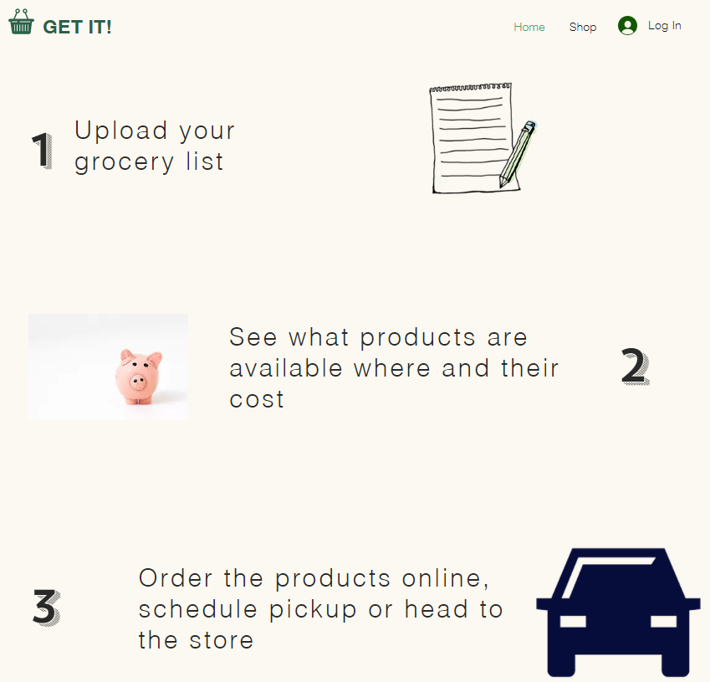
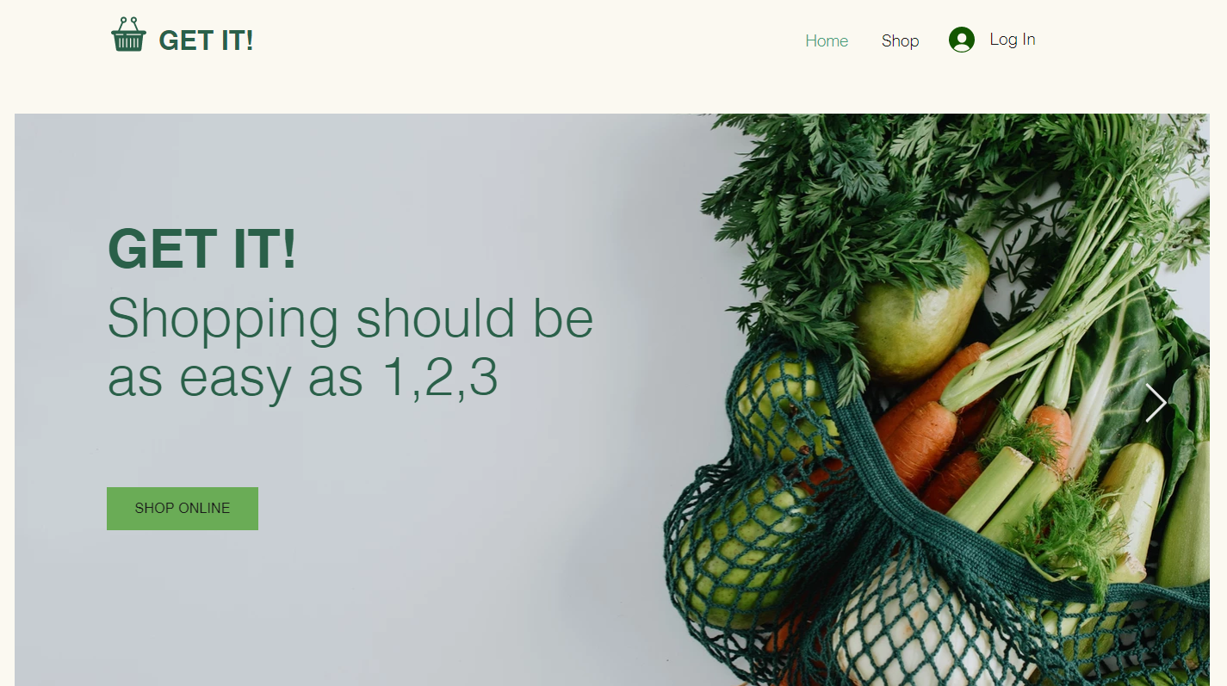
Prototype - Product Availability App
https://vennelagajjala.wixsite.com/mysite-1

Slide 10

Features- Product Availability App
People can upload shopping list to compare availability in various stores
Insight: Product Availability, Less potential for exposure, Saves time and energy
Prices of the items will be compared as well. People can use these prices for price match at stores as well
Insight: People more conscious of spending
Available as a web, mobile ios and android app
Design Principle: Designing for masses, Intuitive, Easy to use
Connected to Instacart as well as grocery websites for online ordering and delivery options
Insight: Reduce exposure, Shopping online, Convenience

Slide 11
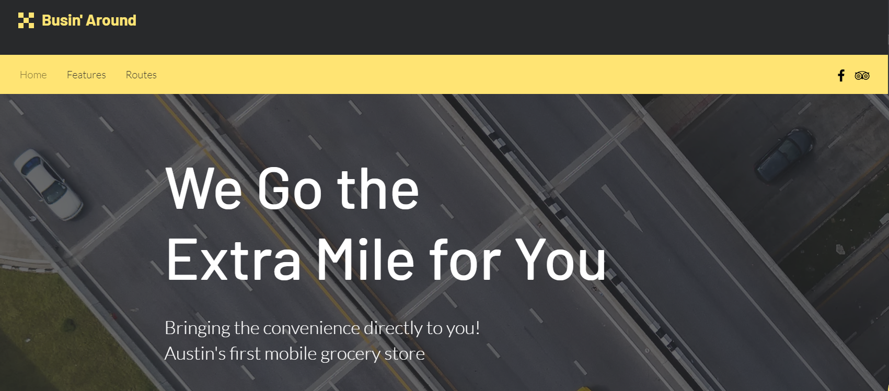
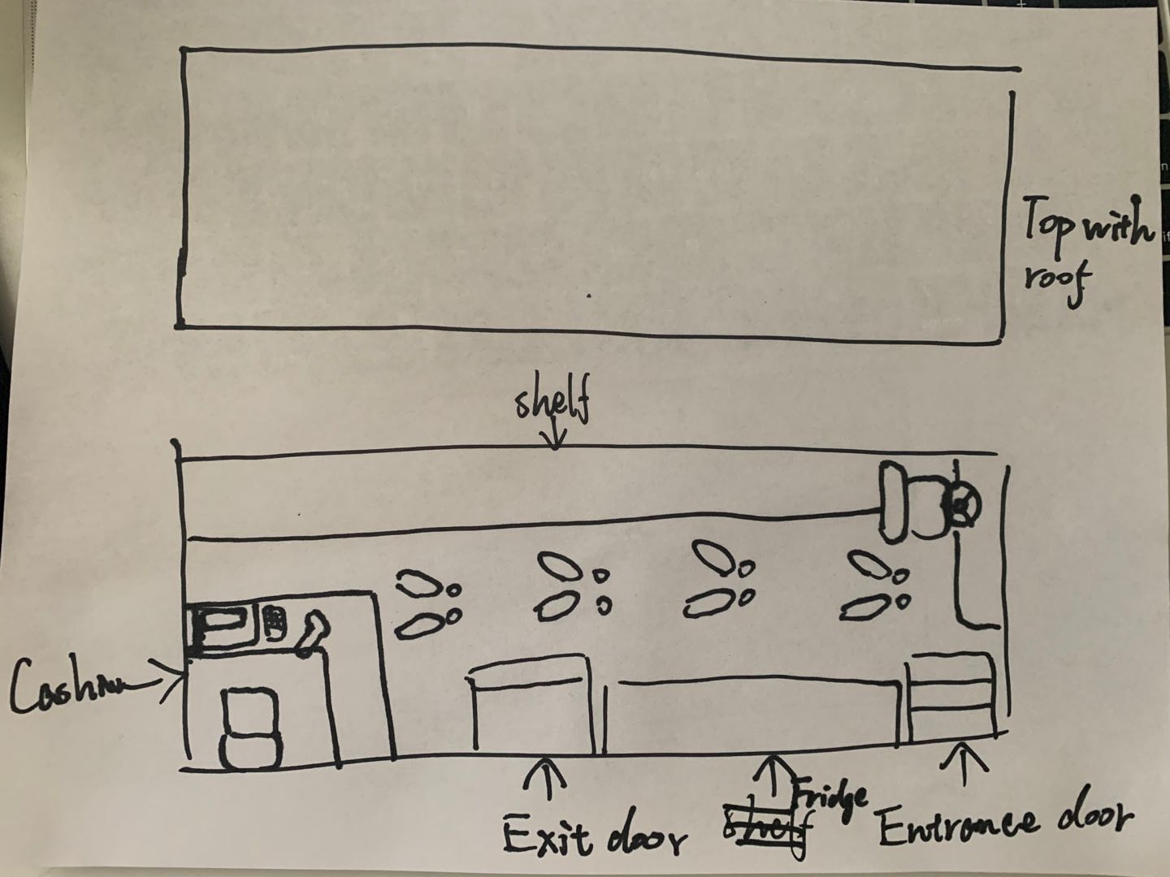
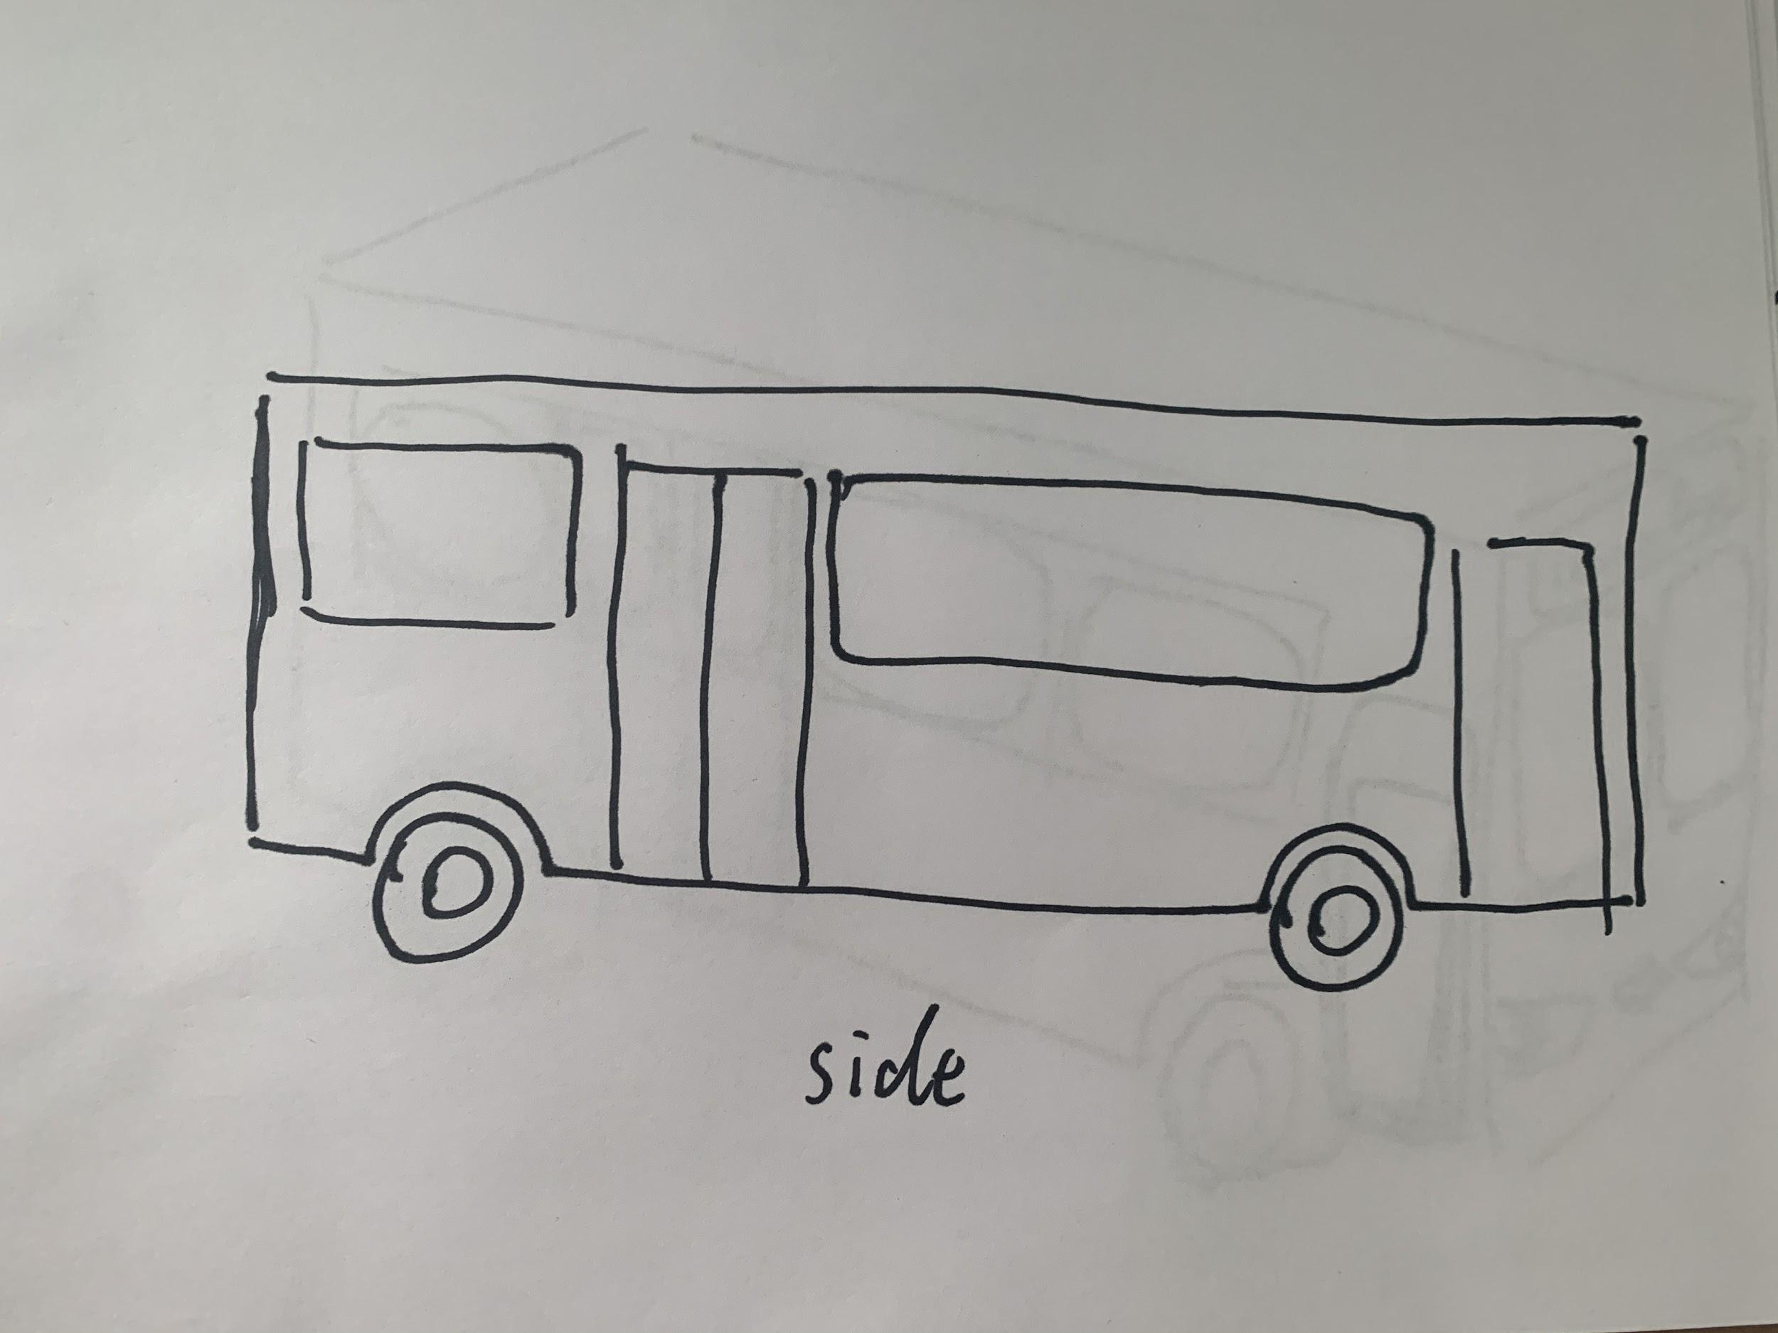
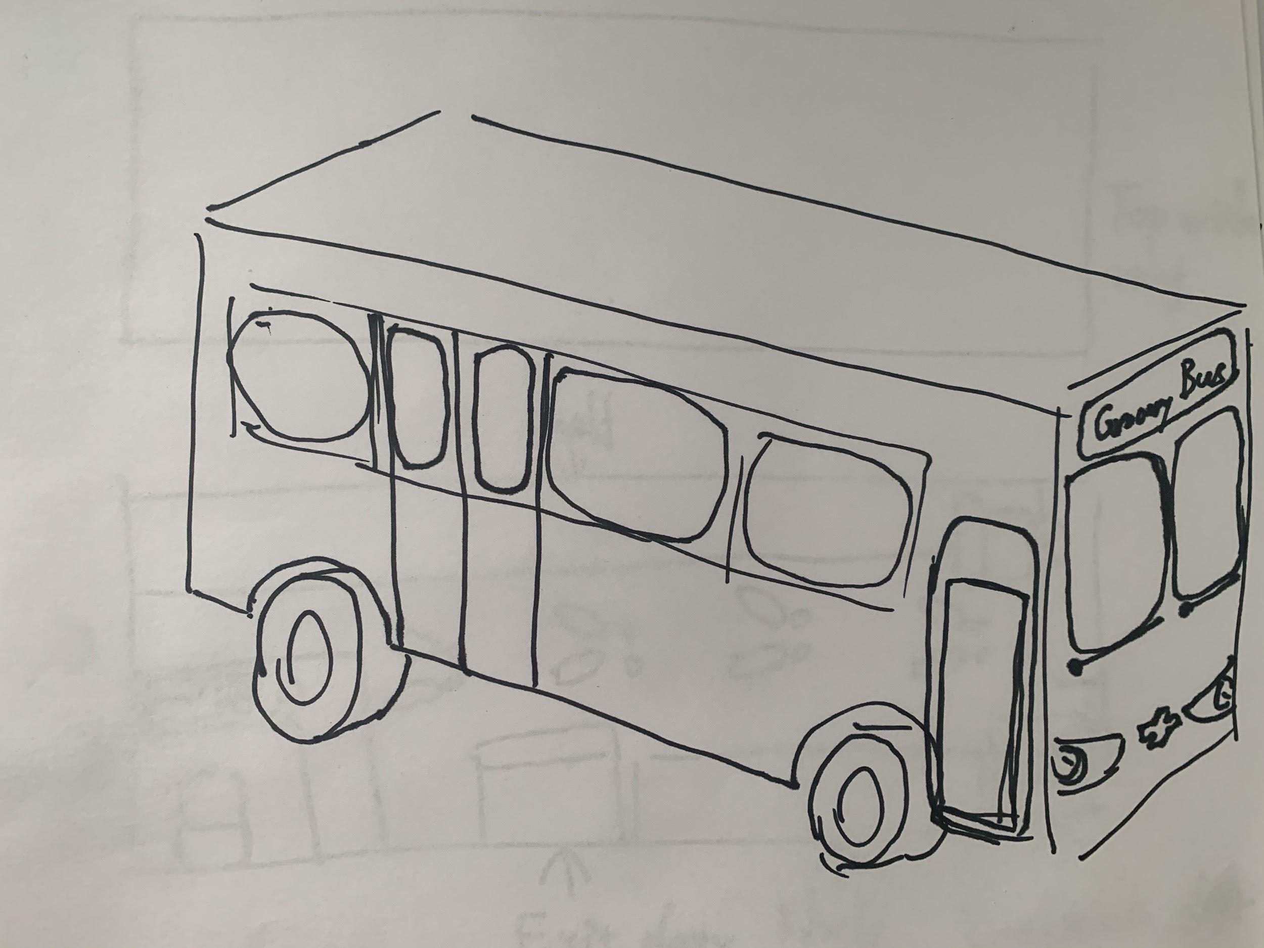
Prototype - Mobile Grocery Bus
https://vennelagajjala.wixsite.com/mysite-2

Slide 12
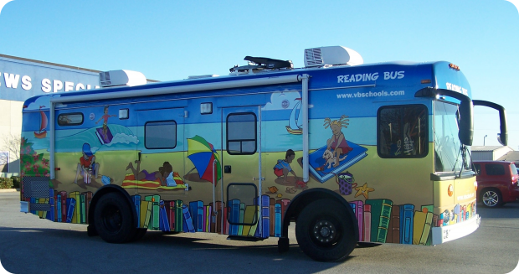
Features - Busin’ Around
Limited capacity so that social distancing can be maintained
Insight: Reducing risk of exposure
All basic-need items should be kept in stock - rice, pasta, toilet paper, veggies
Insight: Product availability, Basic items for cooking
Multiple stops every day so that different communities can be served
Design Principle: Designing for Masses
Connected to an easy to use app available on multiple platforms
Insight: Convenience, Intuitive, See product availability

Slide 13
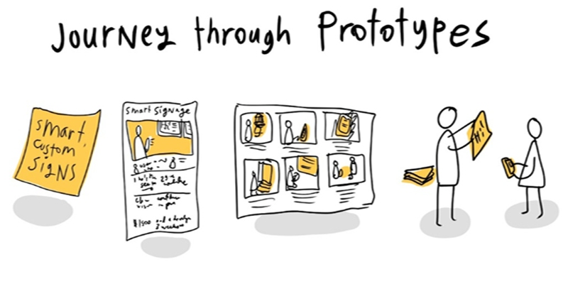
Weaknesses of Prototypes
Product Availability App
Features within app haven’t been fully explored - room to add useful functionality
Can’t solve supply chain issue - prototype can only help guide people to the right place. If product is gone, it’s gone
Data needs to be updated frequently since availability changes fast
Mobile Grocery Store Bus
Currently only have drawing, could use more 3D prototype but time was constrained
Lack of being able to convey what will be sold/provided in the store
Same as app, doesn’t solve supply chain issue - if grocery bus can’t find unavailable products, everyone is out of luck

Slide 14

Testing and Feedback - App
Participants felt that the Product availability app will save lot of time and energy
Participants felt the price matching feature would help them save more
App should display categories which makes searching feasible and understandable - Ex: Asian markets, Indian markets, etc.
Option for reserving the product should also be incorporated
Data should be updated frequently and send notifications to the customer about its availability

Slide 15
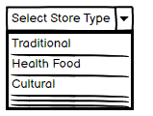
Future Opportunities - App
Provide categories for specialty stores as suggested in testing
Partner with grocery stores to get more accurate and real-time data about availability
Allow customers to hold or reserve products in some way
People should have the ability to save grocery lists

Slide 16
Testing and Feedback - Busin’ Around
Participants felt that this bus will reduce the worries,anxiety because of the present covid situation people are afraid to go to shops.
Bus needs to have set routes that are easily viewable by customers so that they know where to go and when
Have ability to reserve time to shop on bus instead of waiting in line
If customers come to know what are the items present in the bus, then it will be more helpful.
Would help with transportation issues as some people feel public transportation is no longer safe

Slide 17
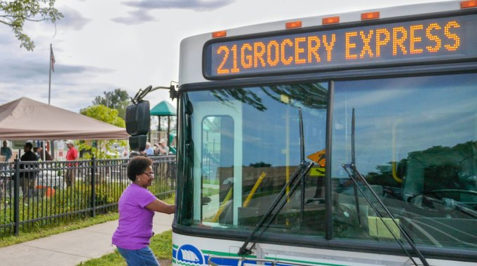
Future Opportunities - Busin’ Around
Have app/website that shows routes and stops and gives ability to reserve time slot to shop
Have different sized busses that carry either specialty items or a more wide stock - corner store vs. grocery store
Need to find a way to keep items always in stock with restock stops so product unavailability isn’t an issue

Slide 18

Reflection
It is easy to come up with a decent starter prototype when you have a good idea formulated - making both the app and bus weren’t difficult because we had a clear vision
Not being able to test out a bigger prototype is something we feel we’re missing out on but due to time it’s understandable
Finding something that could actually be prototyped from our initial list of ideas was harder due to the fact that most of our ideas were just a little too extreme for a real world scenario
Our short version of prototype testing was still useful because our participants were able to give reasonable feedback that should be addressed
There are many useful resources to creating mock-up websites/apps such as Wixsite and Balsamiq that will get your point across without having to add the difficult coding part

